Slide 1


Machine Learning Using Python
www.intellipaat.com

Slide 2


























Agenda for
Today’s Session
₀₁ Get a brief understanding of what exactly is Python
03
Learn and implement various data types in python
05
Understand how to define
and call a function in python
Python Libraries
Flow Control
Webscraping Basics
HTML Basics
Demo: Scraping a Website
Understand the flow of execution of a program
02
Learn about Keywords, Identifiers,
Literals and Operators
04
www.intellipaat.com

Slide 3

Machine Learning around YOU!
www.intellipaat.com

Slide 4




Products Recommendation
Machine Learning Around YOU!
www.intellipaat.com

Slide 5

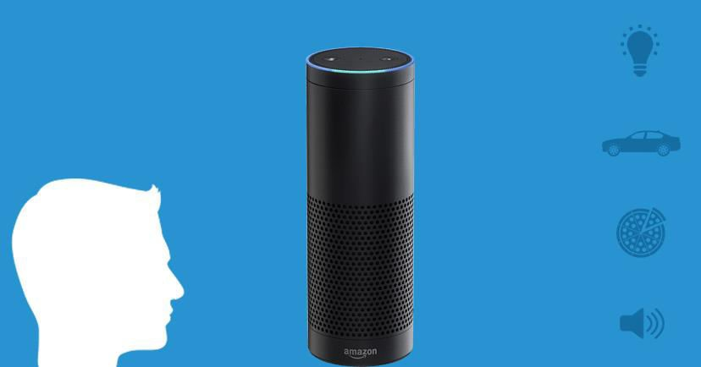
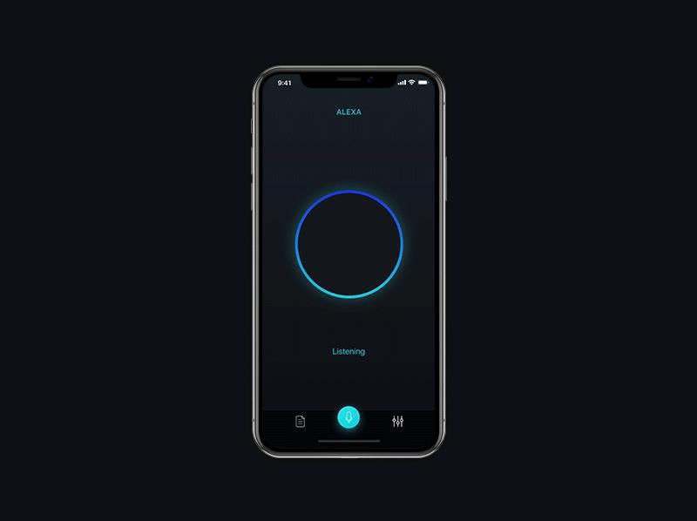
Amazon Alexa
Machine Learning Around YOU!
www.intellipaat.com

Slide 6


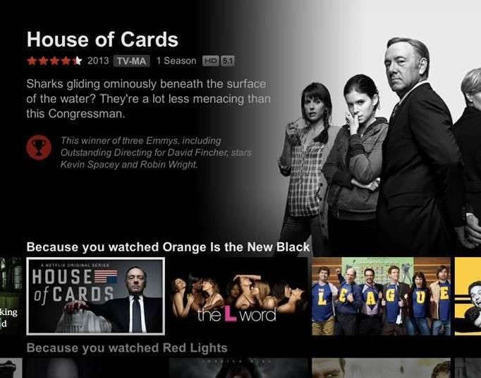

Movie Recommendation
Machine Learning Around YOU!
www.intellipaat.com

Slide 7
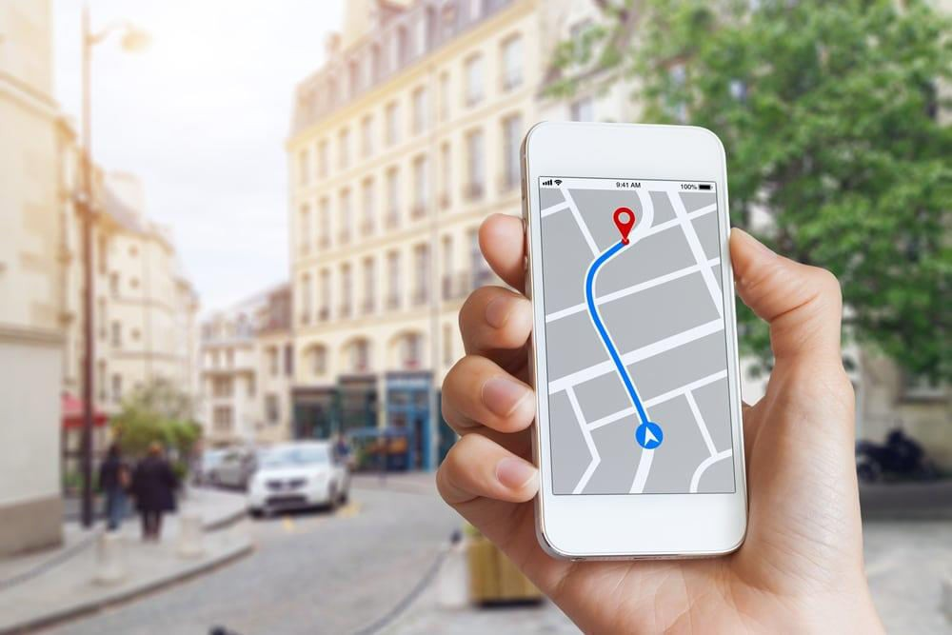

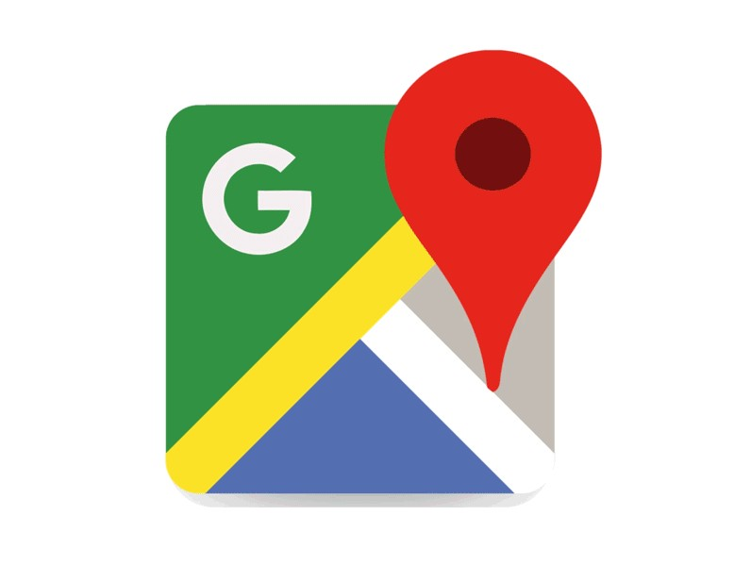
Google Traffic Prediction
Machine Learning Around YOU!
www.intellipaat.com

Slide 8
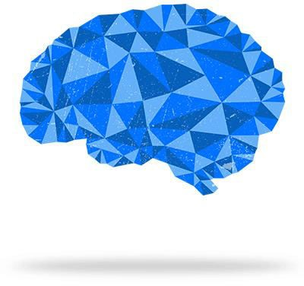
Introduction to Machine Learning
www.intellipaat.com

Slide 9



What is Machine Learning?
Machine Learning Basics
Machine Learning is a subset of artificial intelligence which gives a machine the ability to learn without being explicitly programmed.
Data is the key and the learning algorithm
www.intellipaat.com

Slide 10

What is Machine Learning?
Machine Learning Basics
www.intellipaat.com

Slide 11
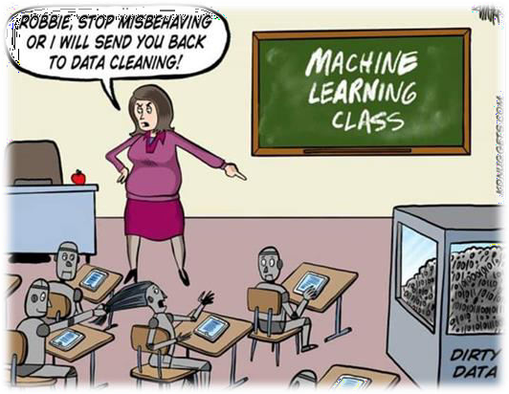
What is Machine Learning?
Machine Learning Basics
www.intellipaat.com

Slide 12

How does Machine Learn?
Machine Learning Basics
www.intellipaat.com

Slide 13
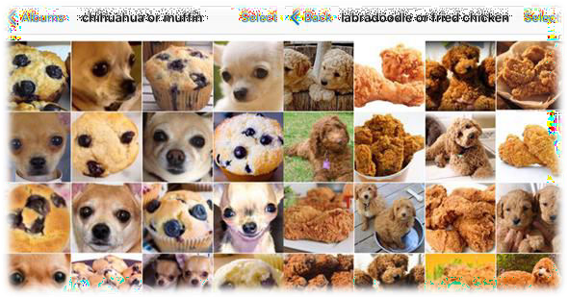
Machine works better with more data…
Machine Training & Testing
www.intellipaat.com

Slide 14

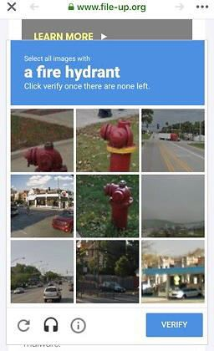
Who knows we are already training a machine…
Machine Training & Testing
www.intellipaat.com

Slide 15

Machine Learning popular MYTH!
www.intellipaat.com

Slide 16



AI vs Machine Learning vs Deep Learning
Machine Learning Myth 01
Artificial Intelligence
Machine Learning
Deep Learning
www.intellipaat.com

Slide 17


AI vs Machine Learning vs Deep Learning
Machine Learning Myth 01
Artificial Intelligence
Area of computer science
that emphasizes the creation of intelligent machines that work and react like humans
www.intellipaat.com

Slide 18





AI vs Machine Learning vs Deep Learning
Machine Learning Myth 01
Artificial Intelligence
Machine Learning
A subset of AI which gives a machine the ability to learn without being explicitly programmed.
www.intellipaat.com

Slide 19




AI vs Machine Learning vs Deep Learning
Machine Learning Myth 01
Artificial Intelligence
Machine Learning
Deep Learning
A subfield ML concerned
with algorithms inspired by the structure and function of the brain called artificial neural networks
www.intellipaat.com

Slide 20
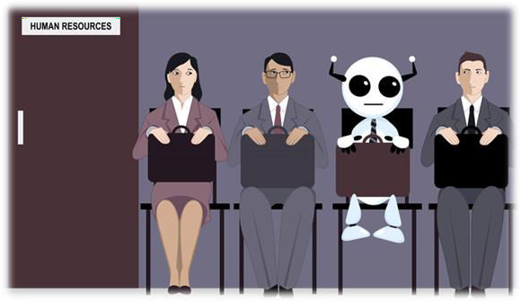
Robots will take up our JOB!
Machine Learning Myth 02
www.intellipaat.com

Slide 21
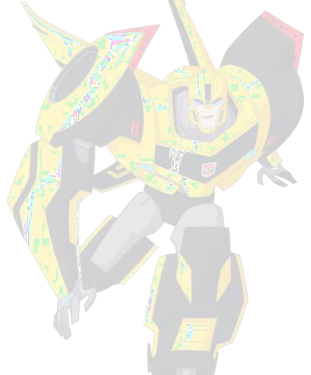
Types of Machine Learning
Machine Learning Types
Supervised Learning
Unsupervised Learning
Reinforcement Learning
www.intellipaat.com

Slide 22




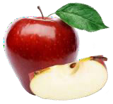




1. Supervised Learning
Machine Learning Types
Training Data
Apple
Apple
Apple
Apple
This is an apple
Supervised Learning
Ohhk noted..
Unsupervised Learning
Reinforcement Learning
www.intellipaat.com

Slide 23
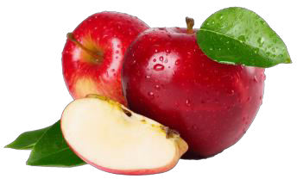
1. Supervised Learning
Machine Learning Types
Training Data
What is this image represent?
Supervised Learning
97% its an apple
Unsupervised Learning
Reinforcement Learning
www.intellipaat.com

Slide 24
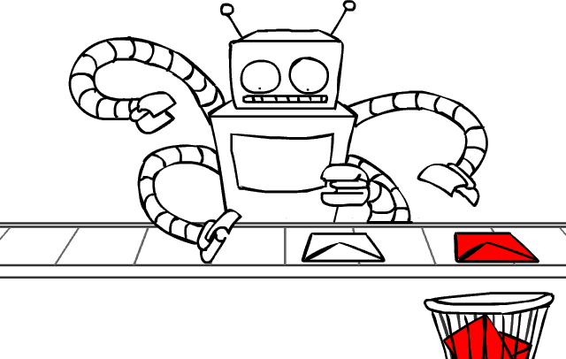
Use Case: Spam Classifier
Machine Learning Types
Supervised Learning
Unsupervised Learning
Reinforcement Learning
www.intellipaat.com

Slide 25

Use Case: Finger Print Analysis
Machine Learning Types
Supervised Learning
Unsupervised Learning
Reinforcement Learning
www.intellipaat.com

Slide 26



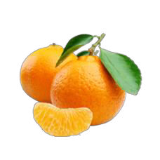

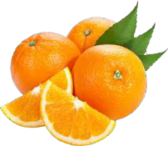
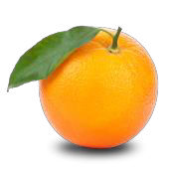


2. Unsupervised Learning
Machine Learning Types
Supervised Learning
…..
Unsupervised Learning
Reinforcement Learning
www.intellipaat.com

Slide 27

2. Unsupervised Learning
Machine Learning Types
Similar Cluster 1
Similar Cluster 3
Supervised Learning
Similar Cluster 2
3 clusters
Unsupervised Learning
Reinforcement Learning
www.intellipaat.com

Slide 28

Use Case: Voice Based Personal Assistant
Machine Learning Types
Supervised Learning
Unsupervised Learning
Reinforcement Learning
www.intellipaat.com

Slide 29
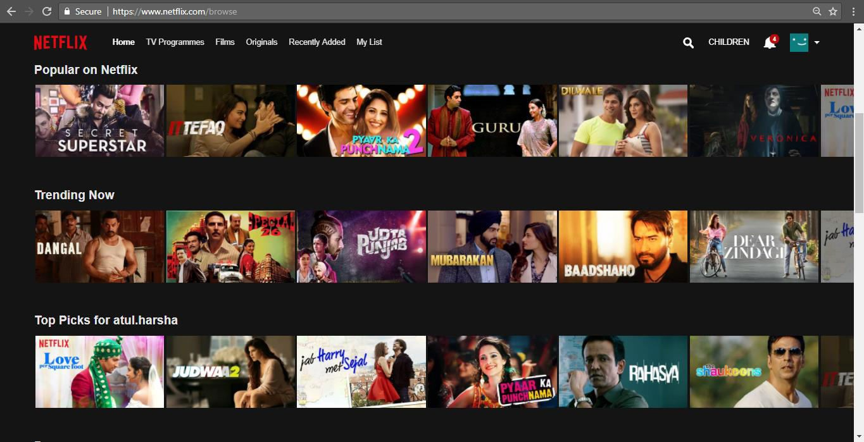

Use Case: Netflix Recommendation
Machine Learning Types
Similar Cluster 1
Supervised Learning
Similar Cluster 2
Unsupervised Learning
Reinforcement Learning
www.intellipaat.com

Slide 30



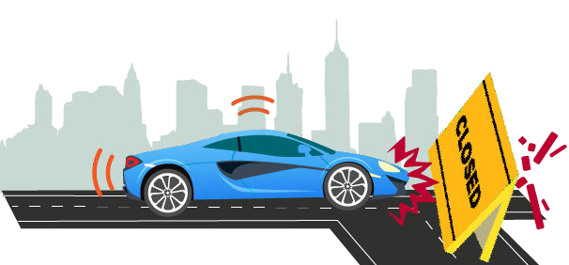




3. Reinforcement Learning
Agent
Environment
Machine Learning Types
1
Observe
2
Select Action using policy
3
Action!
-50 Points
Supervised Learning
4
Reward or Penalty
Unsupervised Learning
From Next Time…
5
Update Policy
Reinforcement Learning
6
Iterate the process
www.intellipaat.com

Slide 31


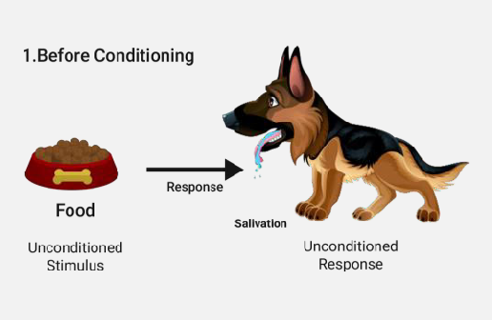
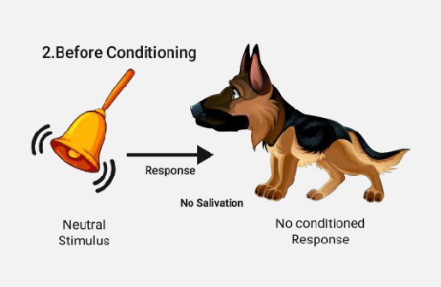


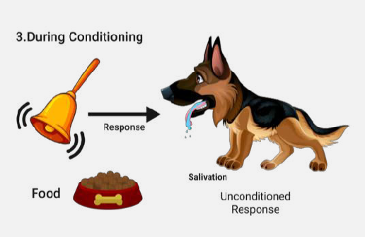
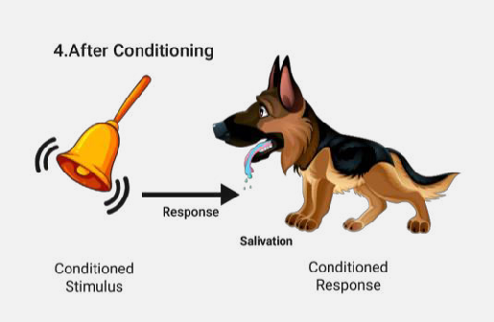
How Pavlov Trained his dog using Reinforcement Learning?
Machine Learning Types
Supervised Learning
Unsupervised Learning
Reinforcement Learning
www.intellipaat.com

Slide 32
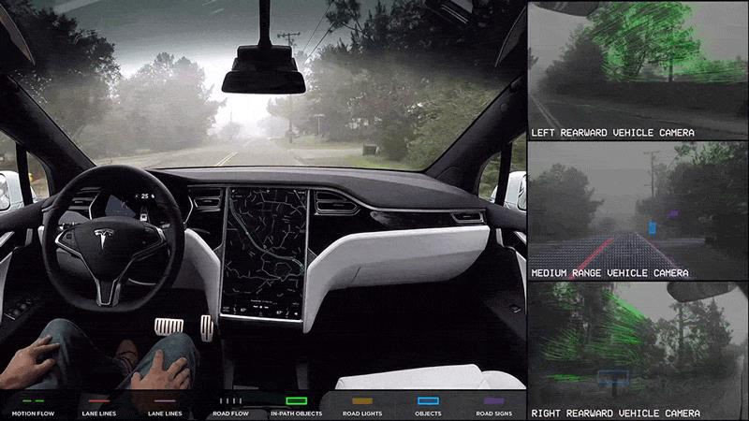
Use Case: Self Driving Cars
Machine Learning Types
Supervised Learning
Unsupervised Learning
Reinforcement Learning
www.intellipaat.com

Slide 33
What you can do with Machine Learning?
www.intellipaat.com

Slide 34





















What is the market value of this house?
Is the email spam or not spam
Which type of house lies in this segment?
Is there any fraud in this transaction?
www.intellipaat.com

Slide 35
Classificatio n Algorithm
Is the person a male or a female?
Is the mail spam or non-spam?
Category is predicted using the data
www.intellipaat.com

Slide 36
Anomaly Detection Algorithm
Is there any fraud in this transaction?
Is someone trying to hack our network?
Identify unusual data points
www.intellipaat.com

Slide 37
Clustering Algorithm
Which type of house lies in this segment?
What type of customer buys this product?
Groups data based on some condition
www.intellipaat.com

Slide 38
Regression Algorithm
What is the market value of this house?
Is it going to rain tomorrow?
Groups data based on some condition
www.intellipaat.com

Slide 39

Cool Machine Learning Projects YOU can use!!
Machine Learning For YOU
https://www.autodraw.com/
https://quickdraw.withgoogle.com/
https://opensource.google.com/projects/explore/machine-learning
https://experiments.withgoogle.com/collection/ai
https://toolbox.google.com/datasetsearch
www.intellipaat.com

Slide 40


DEMO: ML
using
Python
www.intellipaat.com

Slide 41

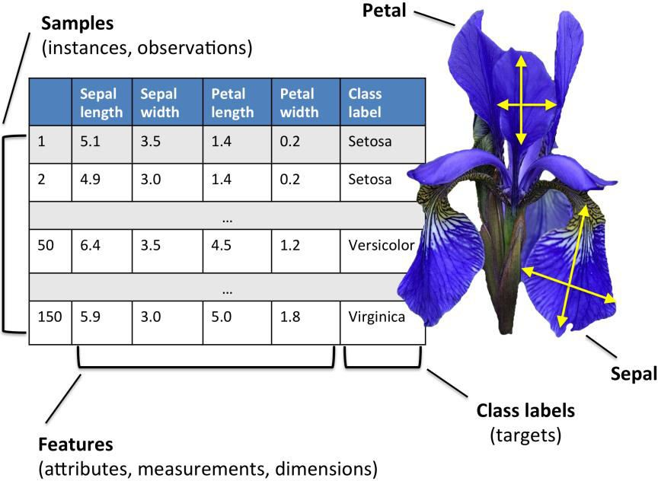
IRIS Flower Dataset
DEMO: ML
using
Python
www.intellipaat.com

Slide 42

QUIZ
www.intellipaat.com

Slide 43

Quiz 1
Which of the following regression is best suited for dealing with categorical dependent variable?
A
Linear Regression
B
Multiple Linear Regression
C
Logistic Regression
D
Quantile Regression
www.intellipaat.com

Slide 44
Answer 1
Which of the following regression is best suited for dealing with categorical dependent variable?
A
Linear Regression
B
Multiple Linear Regression
C
Logistic Regression
D
Quantile Regression
www.intellipaat.com

Slide 45
Quiz 2
Which of the following methods do we use to find the best fit line for data in Linear Regression?
A
Least Square Error
B
Maximum Likelihood
C
Logarithmic Loss
D
Both a and b
www.intellipaat.com

Slide 46
Answer 2
Which of the following methods do we use to find the best fit line for data in Linear Regression?
A
Least Square Error
B
Maximum Likelihood
C
Logarithmic Loss
D
Both a and b
www.intellipaat.com

Slide 47
Quiz 3
Which of the following methods do we use to best fit the data in Logistic Regression?
A
Least Square Error
B
Maximum Likelihood
C
Jaccard distance
D
Both a and b
www.intellipaat.com

Slide 48
Answer 3
Which of the following methods do we use to best fit the data in Logistic Regression?
A
Least Square Error
B
Maximum Likelihood
C
Jaccard distance
D
Both a and b
www.intellipaat.com

Slide 49
Quiz 4
Which of the following is true?
A
Probability and odds are same.
B
Odds and odds ratio are not same.
C
Probability and odds are not same.
D
Both b and c
www.intellipaat.com

Slide 50
Answer 4
Which of the following is true?
A
Probability and odds are same.
B
Odds and odds ratio are not same.
C
Probability and odds are not same.
D
Both b and c
www.intellipaat.com

Slide 51
Quiz 5
Amazon Product Recommendation uses which of
the following machine learning technique?
A
Supervised Machine Learning
B
Unsupervised Machine Learning
C
None
www.intellipaat.com

Slide 52
Answer 5
Amazon Product Recommendation uses which of the following machine learning technique?
A
Supervised Machine Learning
B
Unsupervised Machine Learning
C
None
www.intellipaat.com

Slide 53





www.intellipaat.com
India : +91-7847955955
US : 1-800-216-8930 (TOLL FREE)
sales@intellipaat.com
www.intellipaat.com

